Slide 1


Intro to .NET and C#
Speaker:
Ivan Hlabets

Slide 2


Agenda
What is .NET?
Key benefits
Structure of the .NET platform
CLR, CTS, CIL, Assemblies
C# Language
Overview
Types and operators
Core C# programming constructs
OOP with C#

Slide 3
What is .NET?
.NET is a free, cross-platform, open source developer platform for building many different types of applications.
With .NET, you can use multiple languages, editors, and libraries to build for web, mobile, desktop, gaming, and IoT.
Cross Platform.
Whether you're working in C#, F#, or Visual Basic, your code will run natively on any compatible OS. Different .NET implementations handle the heavy lifting for you:
.NET Core is a cross-platform .NET implementation for websites, servers, and console apps on Windows, Linux, macOS.
.NET Framework supports websites, services, desktop apps,
and more on Windows.
Xamarin/Mono is a .NET implementation for running
apps on all the major mobile operating systems.

Slide 4
What is .NET?
Languages.
You can write .NET apps in C#, F#, or Visual Basic.
One consistent API
.NET Standard is a base set of APIs that are common to all .NET implementations. Each implementation can also expose additional APIs that are specific to the operating systems it runs on.
Libraries.
To extend functionality, Microsoft and others maintain a healthy package ecosystem built on .NET Standard.

Slide 5
Key benefits
Memory management
A common type system
An extensive class library
Development frameworks and technologies
Language interoperability
Version compatibility
Side-by-side execution
Multitargeting

Slide 6
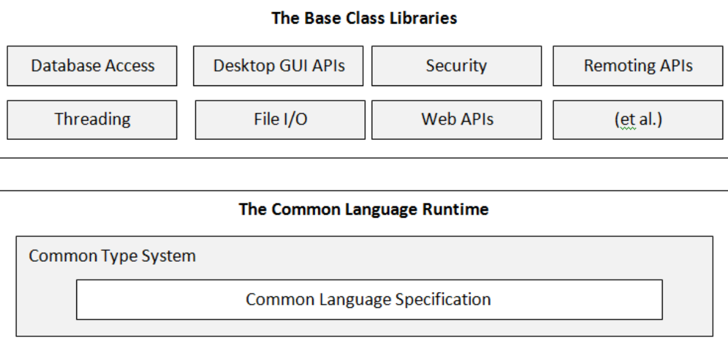
Structure of the .NET platform

Slide 7
CLR, CTS, and CLS
Common Language Runtime, or CLR.
The primary role of the CLR is to locate, load, and manage .NET objects on your behalf. The CLR also takes care of a number of low-level details such as memory management, application hosting, coordinating threads, and performing
security checks (among other low-level details).
Common Type System, or CTS.
The CTS specification fully describes all possible data types and all programming constructs supported by the runtime, specifies how these entities can interact with each other, and details how they are represented in the .NET metadata format.
Common Language Specification, or CLS.
Related specification that defines a subset of common types and programming constructs that all .NET programming languages
can agree on.

Slide 8
CLR terms
.NET compiler.
Compiles source code to CIL (Common Intermediate Language).
JIT compiler.
Compiles CIL code to specific machine commands for executing in the runtime.
Garbage collector.
Manages the allocation and release of memory for application.
Assembly.
The fundamental unit of deployment, version control, reuse, activation scoping, and security permissions for a .NET-based application. It provides the common language runtime with the information it needs to be aware of type implementations. You can think of an assembly as a collection of types and resources that form a logical unit of functionality and are built to work together.

Slide 9
Compiling in CLR
Source code
Compiler
Assembly
C#, VB, F#,…
csc.exe
vbc.exe,
…
CIL, metadata, and manifest
(*.dll or *.exe)

Slide 10
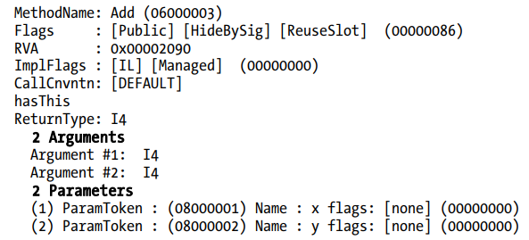
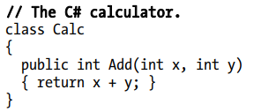
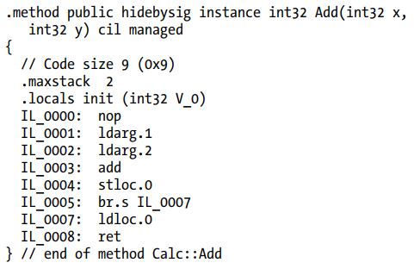
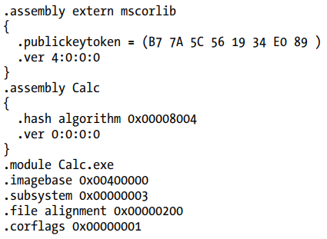
The role of the CIL and assembly
Metadata
C# code
CIL code
Manifest

Slide 11
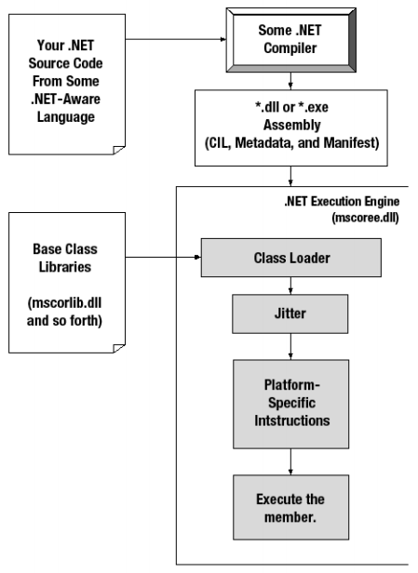
Executing in the CLR

Slide 12
CTS
Type
Value types
Reference types
Pointers
Simple types
enum
struct
class
interface
array
delegate
bool
char
Numeric types
User defined types
sbyte
short
int
long
byte
ushort
uint
ulong
float
double
decimal

Slide 13
Embedded CTS types
CTS | VB. NET | C# | Managed Extensions for C++
System.Byte | Byte | byte | unsigned char
Sytem.SByte | SByte | sbyte | signed char
Sytem.Int16 | Short | short | short
Sytem.Int32 | Integer | int | int or long
Sytem.Int64 | Long | long | __int64
Sytem.Uint16 | UShort | ushort | unsigned short
Sytem.Uint32 | UInteger | uint | unsigned int або unsigned long
System.Object | Object | object | Object^
Sytem.Uint64 | ULong | ulong | unsigned __int64
System.Single | Single | float | Float
System.Double | Double | double | Double
System.Char | Char | char | wchar_t^
System.String | String | string | String^
Sytem.Decimal | Decimal | decimal | Decimal
System.Boolean | Boolean | bool | Bool

Slide 14
General methods
public string ToString()
public bool Equals(object obj)
public int GetHashCode()
public Type GetType()
public static bool ReferenceEquals(object objA, object objB)
public static bool Equals(object objA, object objB)
protected object MemberwiseClone()
protected virtual void Finalize()

Slide 15

Classes
A class is a reference type that can be derived directly from another class and that is derived implicitly from System.Object. The class defines the operations that an object (which is an instance of the class) can perform (methods, events, or properties) and the data that the object contains (fields). Although a class generally includes both definition and implementation (unlike interfaces, for example, which contain only definition without implementation), it can have one or more members that have no implementation.
Class members that have no implementation are abstract members. A class that has one or more abstract members is itself abstract; new instances of it cannot be created.
A class can implement any number of interfaces, but it can inherit from only one base class in addition to System.Object, from which all classes inherit implicitly.

Slide 16
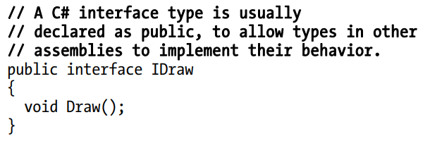
Interfaces
Interfaces can have properties, methods, and events, all of which are abstract members; that is, although the interface defines the members and their signatures, it leaves it to the type that implements the interface to define the functionality of each interface member.

Slide 17
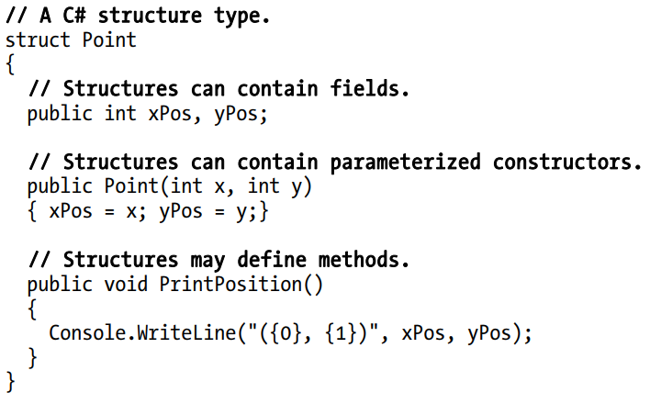
Structures
A structure is a value type that derives implicitly from System.ValueType, which in turn is derived from System.Object. A structure is very useful for representing values whose memory requirements are small, and for passing values as by-value parameters to methods that have strongly typed parameters.

Slide 18
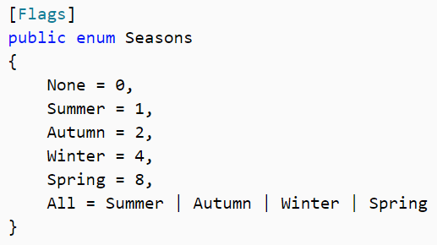
Enumerations
An enumeration (enum) is a value type that inherits directly from System.Enum and that supplies alternate names for the values of an underlying primitive type. An enumeration type has a name, an underlying type that must be one of the built-in signed or unsigned integer types (such as Byte, Int32, or UInt64), and a set of fields. The fields are static literal fields, each of which represents a constant.

Slide 19

Delegates
Delegates are reference types that serve a purpose similar to that of function pointers in C++. They are used for event handlers and callback functions in .NET. Unlike function pointers, delegates are secure, verifiable, and type safe. A delegate type can represent any instance method or static method that has a compatible signature.
A parameter of a delegate is compatible with the corresponding parameter of a method if the type of the delegate parameter is more restrictive than the type of the method parameter, because this guarantees that an argument passed to the delegate can be passed safely to the method.
Similarly, the return type of a delegate is compatible with the return type of a.

Slide 20
Type members
Fields
Properties
Methods
Constructors
Events
Nested types

Slide 21
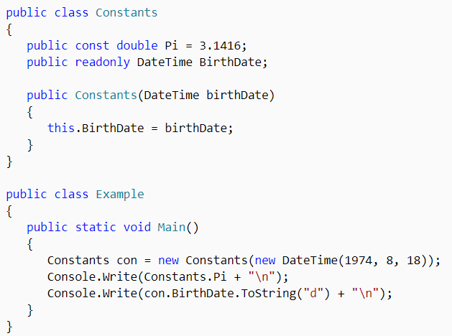
Examples

Slide 22
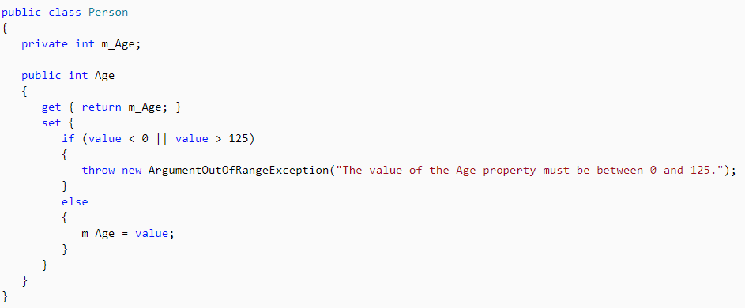
Examples

Slide 23
C# Overview

Slide 24
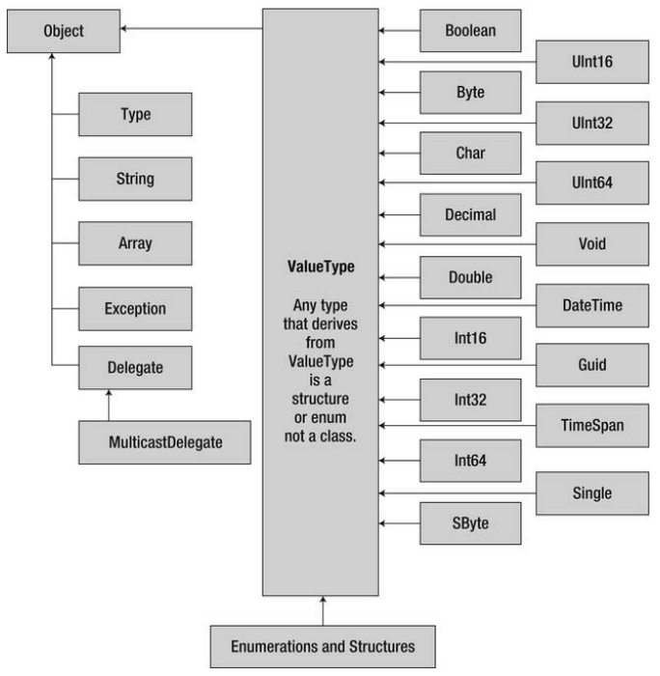
C# Data Types

Slide 25
C# keyword
new
return
void
var
params
ref
out
yield
is
as
virtual
override
base

Slide 26
C# Constructs
Iteration constructs
- for
- foreach
while
- do/while
Decision constructs
- if/else
- switch/case

Slide 27
C# access modifiers
- private
- protected
- public
- internal
- sealed
- partial
- abstract
- static

Slide 28

Thank you!

